Slide 1


Ongoing Site Structure Recommendations

Slide 2

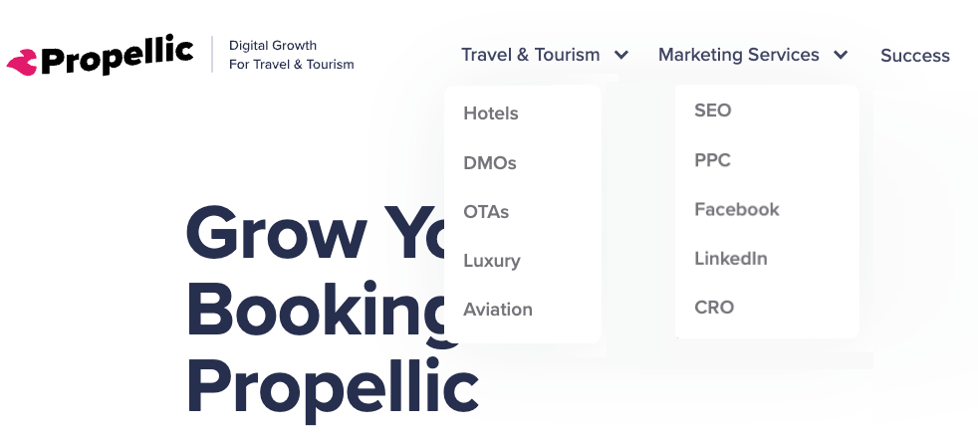

Slide 3


URL Recommendations
Page | URL
Hotels | https://propellic.com/hotel-marketing https://propellic.com/hotel-marketing/seo https://propellic.com/hotel-marketing/ppc
DMOs | https://propellic.com/destination-marketing https://propellic.com/destination-marketing/seo https://propellic.com/destination-marketing/facebook-ads
OTAs | https://propellic.com/ota/ https://propellic.com/ota/seo/ https://propellic.com/ota/cro/
Luxury | https://propellic.com/luxury-travel/ https://propellic.com/luxury-travel/seo/ https://propellic.com/luxury-travel/ppc/
Page | URL
SEO | https://propellic.com/travel-seo/ or https://propellic.com/travel/seo/
PPC | https://propellic.com/travel-ppc/ or https://propellic.com/travel/ppc/
Facebook | https://propellic.com/travel-facebook/ or https://propellic.com/travel/facebook/
LinkedIn | https://propellic.com/travel-linkedin/ or https://propellic.com/travel/linkedin/

Slide 4
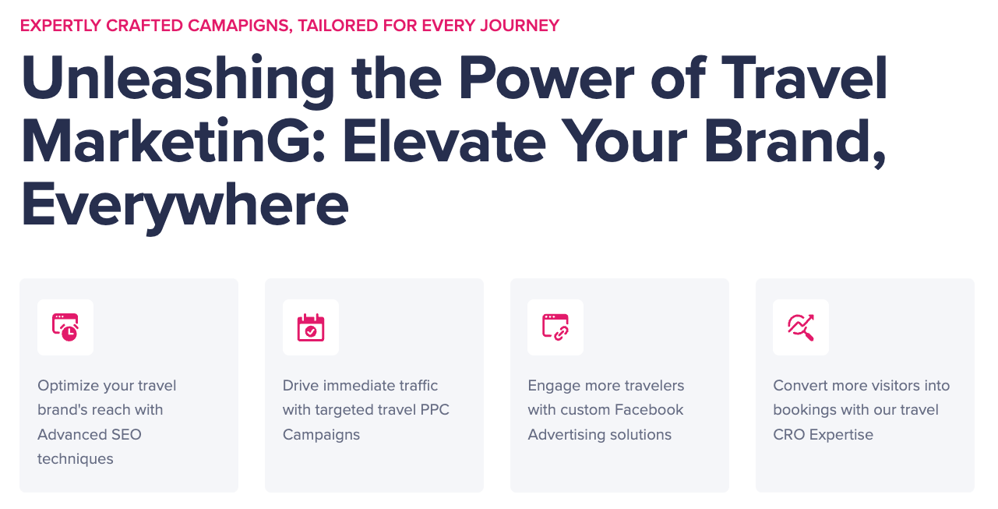




Travel Marketing & Advertising
https://propellic.com/travel/
URL
SEO - https://propellic.com/travel/seo/
PPC - https://propellic.com/travel/ppc/
Facebook - https://propellic.com/travel/facebook/
LinkedIn - https://propellic.com/travel/linkedin/

